Slide 1
Hazard Mitigation Grant Program (HMGP)
Coastal States Organization
Coastal Hazards, Planning, Adaptation Work Group| October 12, 2021
Notes:
Ben starts the presentation on this slide

Slide 2
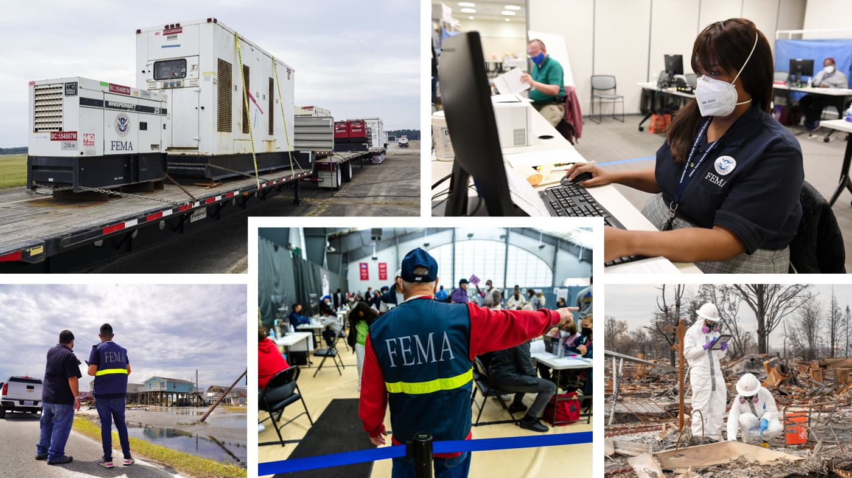
What is Hazard Mitigation?
Any sustained action taken to reduce or eliminate long-term risk to people and property from natural hazards and their effects

Slide 3
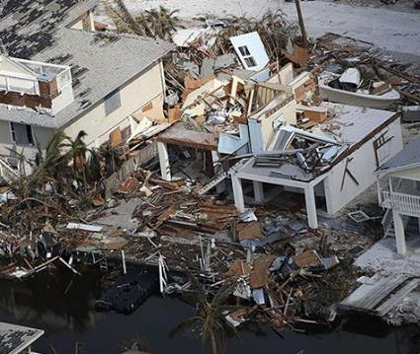
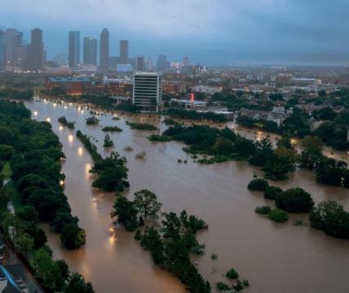
Why is Hazard Mitigation Important?
Natural disasters cost American’s millions.
Community resiliency means being prepared for anticipated hazards such as floods, earthquakes and wildfire.
Communities should have hazard mitigation plans to identify ways prepare for and protect against, future disasters.
2019 is the sixth consecutive year (2015-2020) in which
10 separate billion-dollar weather and climate disaster events have impacted the United States. Further, 2020 had the most hurricanes on record.

Slide 4
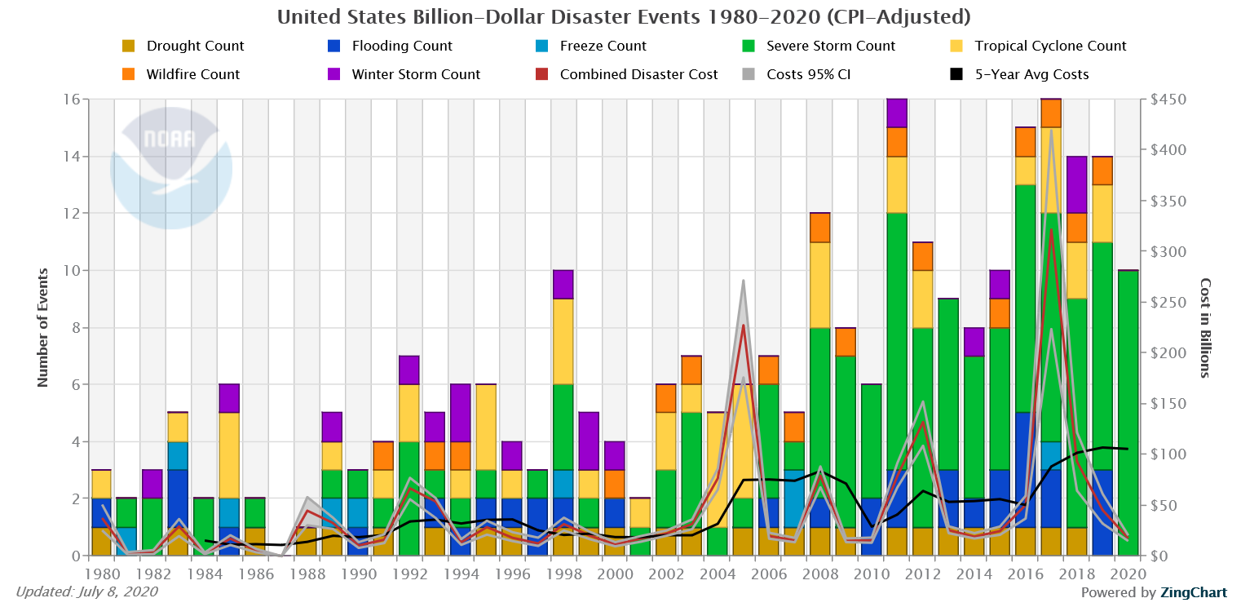
“The number and cost of disasters are increasing” - NOAA
SOURCE: NOAA, available at: https://www.ncdc.noaa.gov/billions/time-series/US
Notes:
Connect the disaster $ with hazard mitigation funding

Slide 5
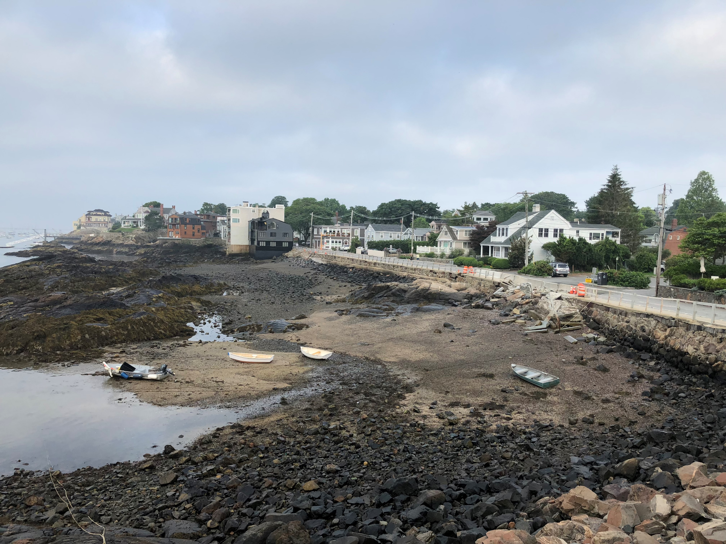
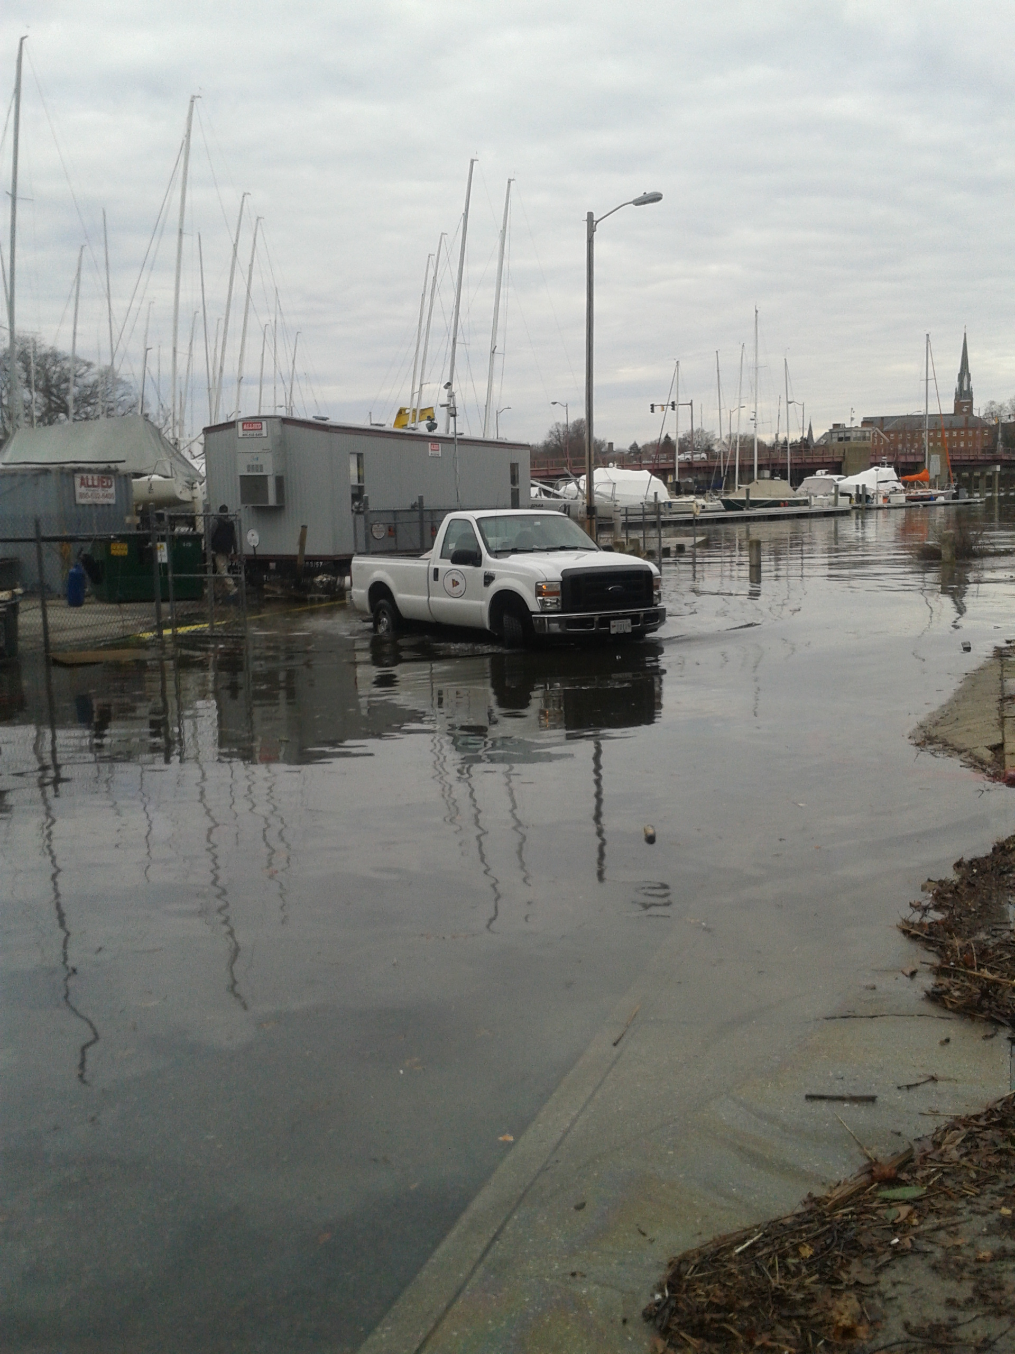
Coastal Hazards
Notes:
Examples of eroding/undercut coastal infrastructure and flooding

Slide 6
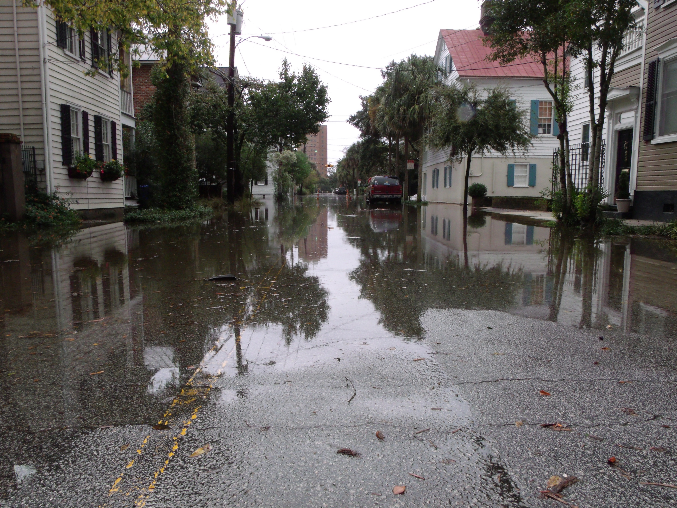
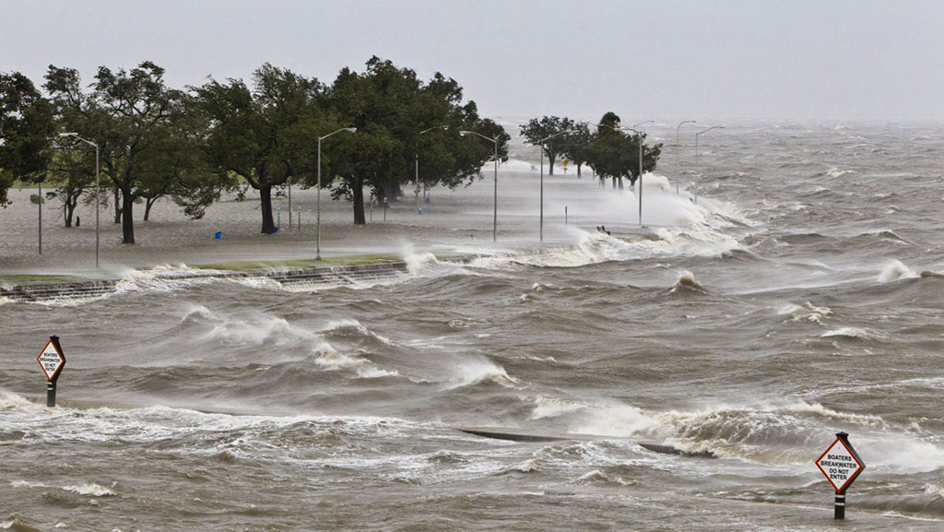
Coastal Hazards
Notes:
Examples of sunny day/high tide flooding and coastal storms

Slide 7
HMGP Funding
What is HMGP? Who can get HMGP funding? What is the application process?

Slide 8
FEMA Grant Programs
Annual Programs
Post-Disaster Programs
Building Resilient Infrastructure and Communities (BRIC)
Flood Mitigation Assistance (FMA)
Hazard Mitigation Grant Program (HMGP)
HMGP Post Fire Grant
Support for states, local communities, tribes, and territories to undertake hazard mitigation projects
Funding for properties insured under the National Flood Insurance Program for planning and projects to reduce or eliminate risk of flood damage
Assist in implementing long-term hazard mitigation planning and projects
Assist communities in implementing hazard mitigation measures following wildfire
Federal Emergency Management Agency
8

Slide 9
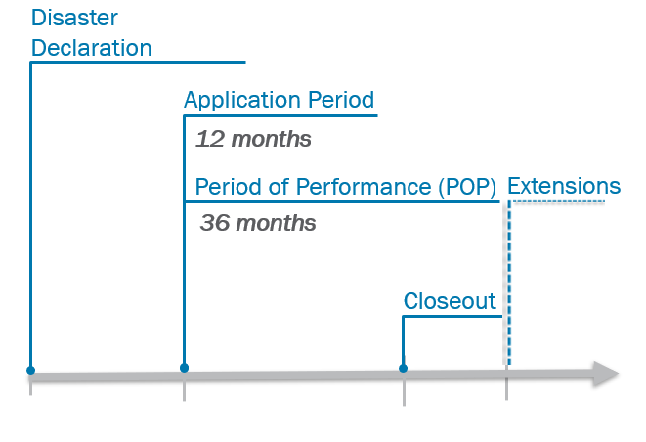
HMGP Funding
Legislative Authority: Stafford Act of 1988, Section 404
HMGP authorized after Presidential Disaster Declaration
Funding depends on disaster costs
  15% for Standard State Mitigation Plans
  20% for Enhanced State Mitigation Plans
Notes:
Communities should have projects identified before funding becomes available

Slide 10

Application Process
Subapplicants
Federally Recognized Tribes
Private
Non-Profits
Tribal Agencies
Local Gov/ Communities
State Agencies
Applicants
Federally Recognized Tribes
States
Territories
FEMA does not select projects; FEMA reviews and funds projects submitted by applicants.

Slide 11
HMGP Eligibility Criteria
Applicants and Subapplicants need an approved mitigation plan
  Projects must be consistent with plan goals
Applications must include:
  Scope of work, project schedule and budget
  Environmental and historical preservation
  25% non-federal match
  Cost effectiveness (Benefit Cost Analysis)
Notes:
Last slide for Ben
Emphasize the importance of developing strong mitigation plans and identifying specific projects

Slide 12
How can HMGP help my community?
Eligible Projects and Activities
Notes:
Melanie starts presenting on this slide

Slide 13
HMGP Funding Categories
Projects
Planning
Advance Assistance
Develop mitigation strategies and obtain data
to prioritize, select, and develop complete
HMGP applications
Planning activities can include assessing risk, updating the mitigation strategy, and promoting resilience to reflect current
disaster recovery goals
5% Initiative
Up to 5% of HMGP funds can be set aside for mitigation activities difficult to evaluate using
FEMA-approved cost-effectiveness methodologies
Management
Indirect costs and administrative expenses that are reasonably incurred in administering an award or subaward
Regular HMGP Projects
Projects that increase resilience and public safety, reduce injuries and loss of life, and reduce damages
Management
15% of HMGP award for indirect costs and administrative expenses incurred in administering an award

Slide 14
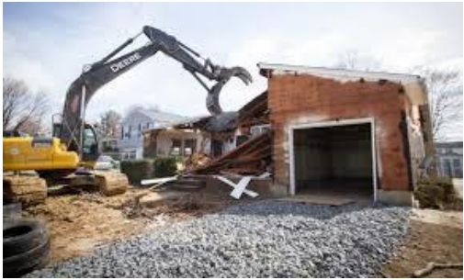
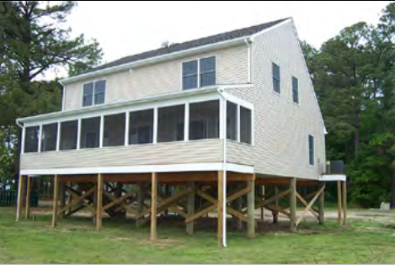
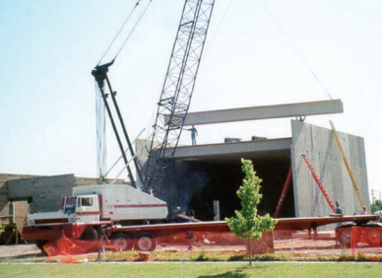

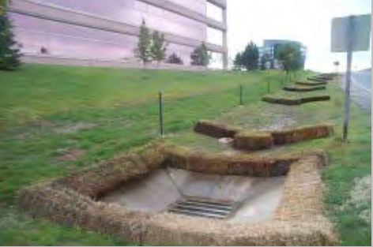
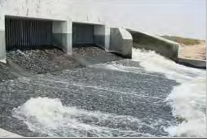
Eligible Mitigation Activities
Property acquisition
Structure elevation
Safe room
Drainage and culvert improvement
Wildfire
Stormwater upgrade

Slide 15
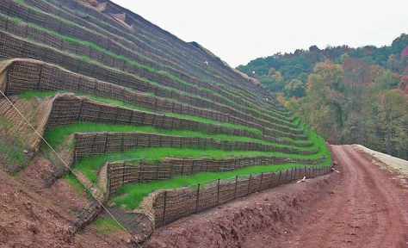
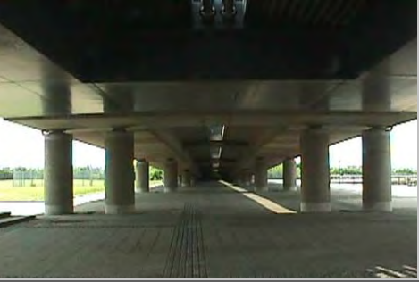
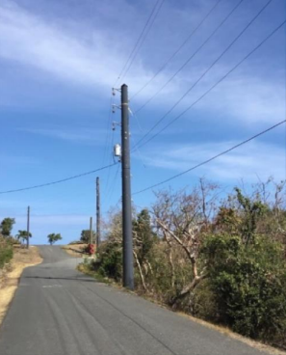
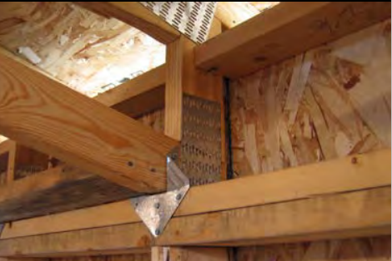
Eligible Mitigation Activities
Slope stabilization
Seismic and wind retrofit
Infrastructure and utility retrofit

Slide 16
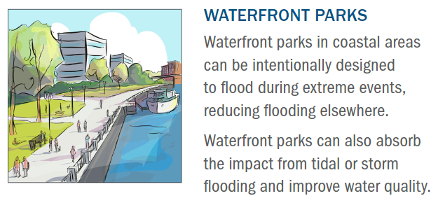
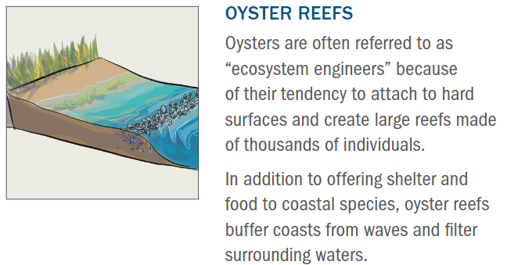
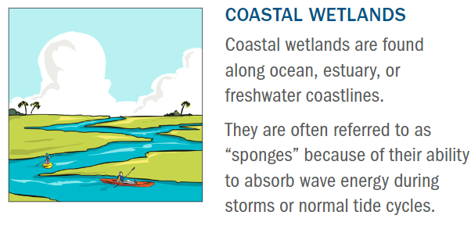
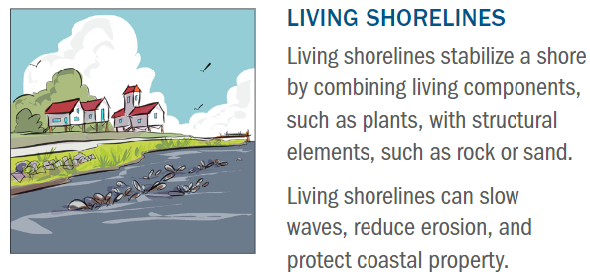
Nature-Based Solutions – Coastal Environments
Waterfront parks in coastal areas can be intentionally designed to flood during extreme events, reducing flooding elsewhere.
Waterfront parks can also absorb the impact from tidal or storm flooding and improve water quality.
Oysters are often referred to as “ecosystem engineers” because of their tendency to attach to hard surfaces and create large reefs made of thousands of individuals.
In addition to offering shelter and food to coastal species, oyster reefs buffer coasts from waves and filter surrounding waters.
Coastal wetlands are found along ocean, estuary, or freshwater coastlines.
They are often referred to as “sponges” because of their ability to absorb wave energy during storms or normal tide cycles.
Living shorelines stabilize a shore by combining living components, such as plants, with structural elements, such as rock or sand.
Living shorelines can slow waves, reduce erosion, and protect coastal property.
Notes:
Many coastal applications assist in the protection of lands and habitats against wave action and erosion. Oyster reefs have an added benefit of sheltering and nourishing coastal species. Waterfront parks both absorb impacts from flooding but also improve water quality and offer recreational benefits.

Slide 17
Hazard Mitigation At Work
Example projects from the coastal U.S.

Slide 18
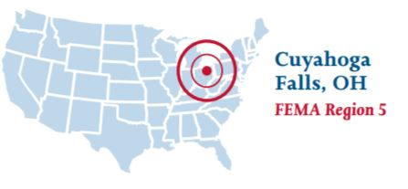
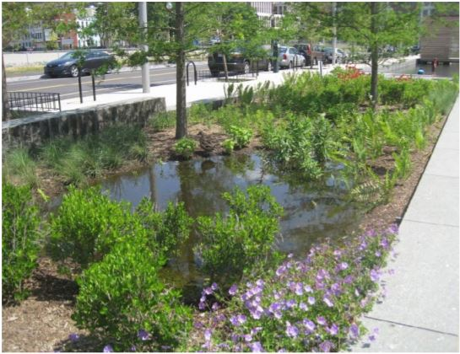
Cuyahoga Falls Rain Garden Reserve
Acquired and demolished four homes that experienced repetitive flooding losses
Built a 24,000-square-foot municipal rain garden in the open space
From Mitigation Action Portfolio (MAP):
https://www.fema.gov/sites/default/files/documents/feam_fy21-bric-mitigation-action-portfolio.pdf
Rain Garden Reserve
Photo credit: Alisha Goldstein, EPA

Slide 19
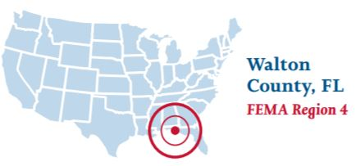
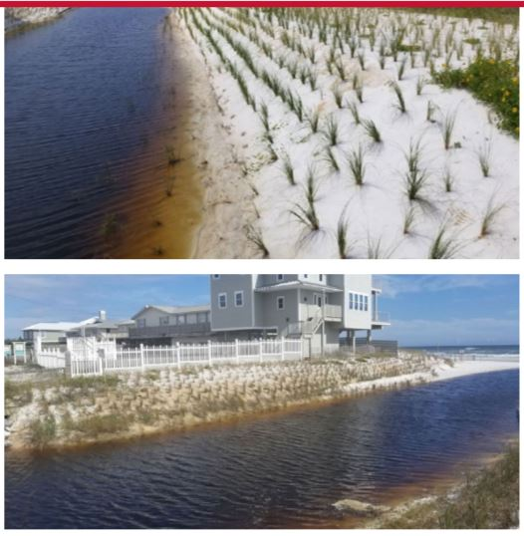
Oyster Lake Outfall Improvement
Oyster Lake outfall is critical for regulating water levels and mitigating flooding
Outfall was reinforced while preserving natural vegetation with 2,000 sea oats planted
Selected system provided slope stabilization and erosion control
From Mitigation Action Portfolio (MAP):
https://www.fema.gov/sites/default/files/documents/feam_fy21-bric-mitigation-action-portfolio.pdf
Multiple beach front homes are located at the mouth of the outfall
Source: Propex GeoSolutions, https://propexgeosolutions.pixieset.com/oysterlakestabilization/
Notes:
https://www.fema.gov/sites/default/files/documents/feam_fy21-bric-mitigation-action-portfolio.pdf- can i use projects listed here

Slide 20
Summary
HMGP funding is available following a Presidential major disaster declaration.
HMGP offers 75% federal funding with 25% non-federal cost share.
Subapplicants must work with Applicants to develop projects and get funding
Eligible activities include construction projects, project scoping, planning-related activities, and management efforts.

Slide 21
Thank you!

Slide 22
Contact Slide Option 2
Ben Prince
benjamin.prince@fema.dhs.gov
Melanie Perello
melanie.perello@fema.dhs.gov
Hazard Mitigation Assistance Division

Slide 23
Resources
HMGP: https://www.fema.gov/grants/mitigation/hazard-mitigation
HMGP Guidance Documents: https://www.fema.gov/sites/default/files/2020-04/HMA_Guidance_FY15.pdf and https://www.fema.gov/sites/default/files/2020-07/fy15_hma_addendum.pdf
FY15 HMA Guidance Fact Sheet: https://www.fema.gov/sites/default/files/2020-07/fy15_guidance_fact_sheet_3March2015.pdf
HMA Program Summary: https://www.fema.gov/sites/default/files/documents/fema_summary-fema-hazard-mitigation-assistance-grant-programs_032321.pdf
BRIC Nature-Based Solutions Guide: https://www.fema.gov/sites/default/files/documents/fema_riskmap-nature-based-solutions-guide_2021.pdf
Grants Management Technical Assistance Resources: https://training.fema.gov/grantsmanagement/
Other Guidance and Tools: https://www.fema.gov/grants/guidance-tools
For Additional Assistance Contact Your State Hazard Mitigation Officers (SHMO): https://www.fema.gov/grants/mitigation/state-contacts

